Slide 1
NG Group Data Office
July 2021

Slide 2
Purpose of the Group Data Office
To help National Grid become Data Driven
A data driven organisation has enabled its data so that it can:
make better, faster decisions
accelerate transformation
become more efficient and effective
enable new opportunities; revenue streams, business models
protect brand and mitigate risk
continuously innovate
enable the business strategy

Slide 3
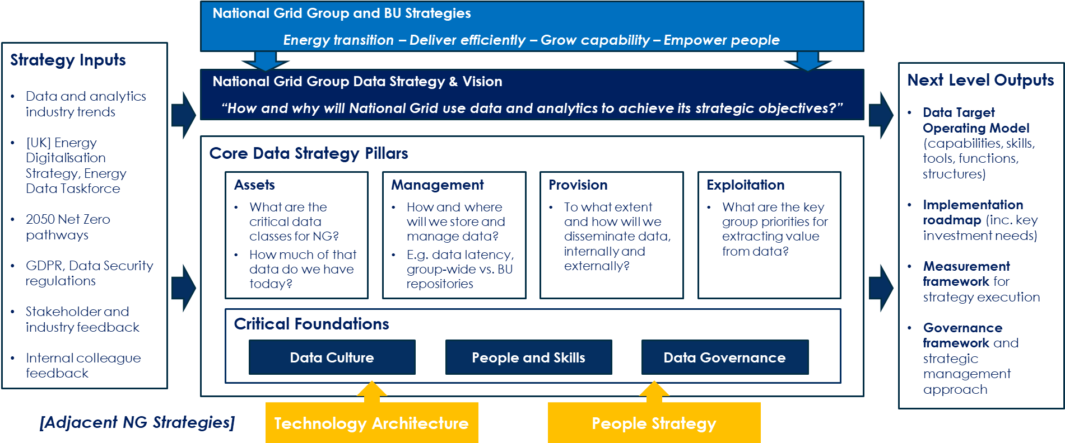
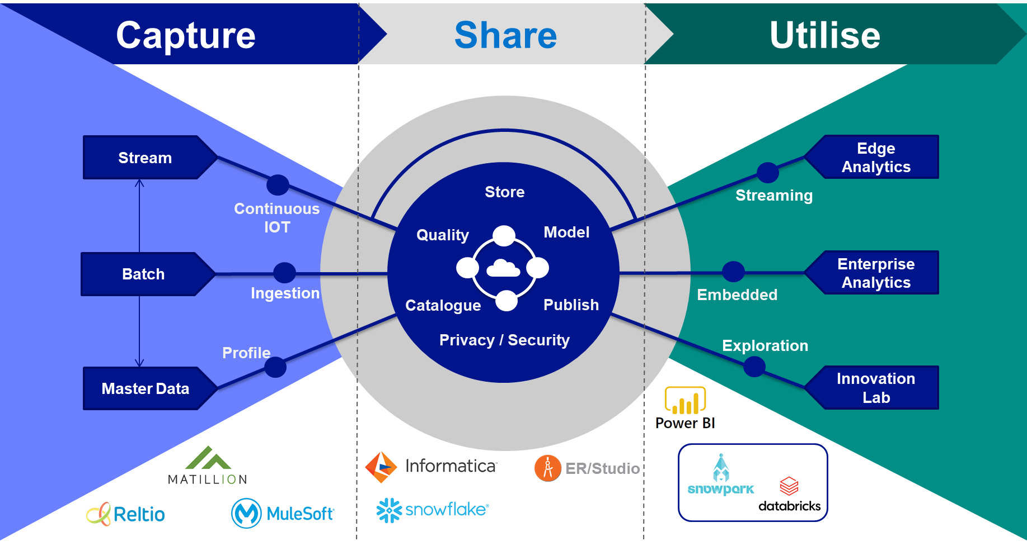
How to help NG become Data Driven
Define, implement, govern and measure a Group Data Strategy

Slide 4
How to help NG become Data Driven
The Group Data Strategy has set some priorities:
Establish a common approach to Strategic Data Transformations across BUs
Technology standards, common data reference architecture, Data Management Standards, hub and spoke operating model, Group wide collaboration around data
Ensure data initiatives lead with value and outcomes
Link BU Data Strategy to Business Strategy, ensure all data MVPs are value led, establish a data value mapping method for use cases and a standard approach for BU Data Strategy
Prioritise Data Mastering and Managing Data as an Asset
Ensure all strategic data projects establish and leverage a reusable model for master data and data management
Adopt Digital Ways of Working for Data
Align the data delivery model with a product operating model. Align with the Digital Hub and Spoke delivery model. Align the Data Technology standards and reference architecture with GridStack

Slide 5
Group Data Office Team
Head of Data & Analytics
Enterprise Data & Analytics Architecture
Data Governance
Data Strategy
Data Platforms & Engineering
Own: Technology & Data Architecture across ‘capture, share and utilise’ of the Group Data Strategy
Technology Standards
Data Reference Architecture
Govern and support BU strategic project delivery
Drive and support architecture reuse and collaboration around data
Own: Data Governance across ‘capture, share and utilise’ of the Group Data Strategy
Data Management Standards
Group IT data risk
Govern and support BU strategic project delivery
Drive and support business teams to manage data as an asset
Own: Group Data Strategy buy-in, execution and governance. Value first approach. Data Culture improvements
Data Strategy templates
Value first approach
Collaboration forums
Govern and support BU strategic project delivery
Drive and support project teams to be led by value
Own: Deployment of strategic data platforms and hub delivery of data engineering
Data project delivery method
Data platform and pipeline operations
Strategic data project delivery
Scale up cost effective data delivery

Slide 6
Group Data Office Stakeholders
Who are our key stakeholders?
Stakeholder area | Names
BU Heads of Data | Preston Large, Nicolas Raad, Alex Kanashiro, Keith Trilloe, Niall Branley, Gary Dionne
BU CIOs | Bob, Krishna, (Sarah), Simon, Norma
BU Lead Data Architects | Peter Lawrence, Joe, Rashmi,
BU Lead Data Governance | Phil Kluko, Andrew Burns, Paul Wilson, Darya,
Group Digital Acceleration | Anil P, Vince M, Mike F, Shashi R
Group CTO | Shannon, Narayan, Bharat, Keith Vargas
BU Executives | …….
TDA | All areas

Slide 7
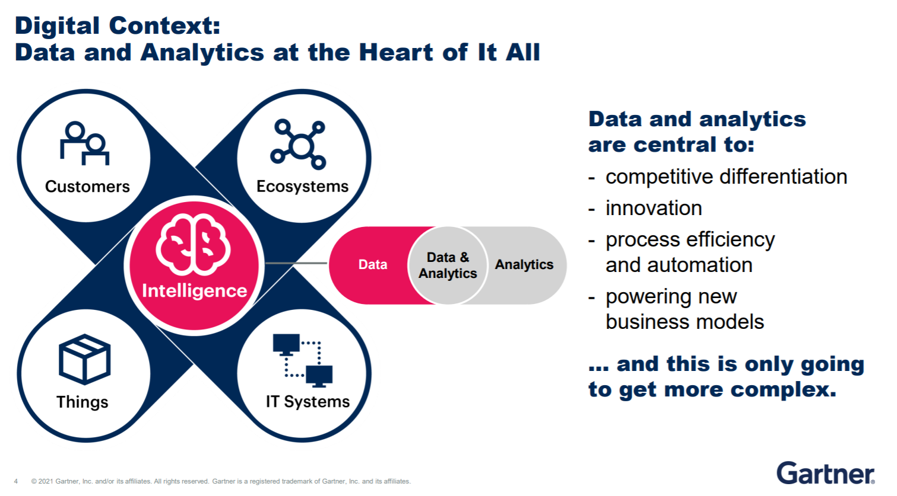
Digital Transformation Engagement

Slide 8
Digital Transformation Engagement
How are we involved in the Digital Transformation
Strategy, Op Model, Roadmap setting
Digital Transformation
Group Business Strategy
Influence, link, enable
Digital Hub
Grp Digital Strategy
Data Products in GridStack
Grp Data Strategy
Digital Delivery
Hub Data Products
BU Strategy
Influence, link, enable
Business Data Products
BU Roadmap
BU Data Strategy
BU Data Transformation
Hub Data CoE support
BU Data Culture
Hub Data Culture support

Slide 9
Roadmap detailed – Data & Analytics
Already in place
Quick wins
(pre March ’22)
FY23 3&4
FY23 Q1&2
Group Data Strategy set
Group wide Data Collaboration started
Enterprise Data Strategy Governance model initiated
Enterprise Data Platform foundation implemented & GridStack aligned
Operating Model aligned: DataOffice / GridStack / Data Engineering / BPR
Enterprise Data Governance active (decisions on GridStack capabilities and cross BU data decisions)
GridStack hub product owners from Data Office in role
BU Data Strategy status and content consolidated
Collaborative cross BU data opportunities proposed
Advanced Analytics (DS/AI) importance understood and CoE proposed
Group Data Strategy updates are collaboratively developed with BU stakeholders
Data Governance Councils active across all BUs and linked to Enterprise Data Governance
Licence to Operate
Data Team restructured and first line recruited
VIA model introduced for ‘Value First’
Product mapping method introduced
Enterprise Data Model foundations in place
New recruits started, stakeholders engaged and productive
Common backlog process in place for GridStack hub data products
BU Data Strategy method documented with GBU
Advanced Analytics CoE roles defined
GridStack data demand process defined
Delivery model for collaborative data initiatives established
Advanced Analytics CoE recruited and Service and Operating Model defined
AI/ML capabilities standardised for GridStack
Skills & Capabilities
BUs aligned to Data Tech Strategy
Commercials agreed with key vendors
Two BUs have value first strategic MVPs, leveraging EDP and products mapped
WDD and CDP first MVP releases
Common GridStack data product backlog providing efficiencies and accelerating BUs
GBU Data Strategy set
EBU, US-C and Global HR Data projects all aligned on GridStack
Additional MVPs and BUs leveraging Data capabilities from GridStack
Advanced Analytics CoE adding value to BUs
Collaborative data initiatives delivering value
Tangible Outcomes

